Slide 1
Message Queue
Back to Basics
By PuGong

Slide 2
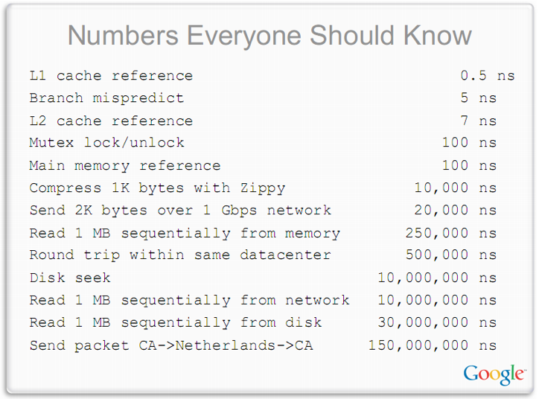

Slide 3
Agenda
What’s Message Queue
Key Points
Message Implementations
Q&A

Slide 4
What’s Message Queue
Message queues provide an asynchronous communications protocol, meaning that the sender and receiver of the message do not need to interact with the message queue at the same time. Messages placed onto the queue are stored until the recipient retrieves them. Message queues have implicit or explicit limits on the size of data that may be transmitted in a single message and the number of messages that may remain outstanding on the queue.
Implementation：ZeroMQ, RabbitMQ, ActiveMQ, Kafka, RocketMQ etc

Slide 5
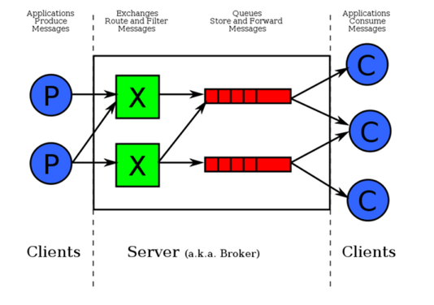
What’s Message Queue

Slide 6
Why using Message Queue
Decoupling
Asynchronous Communication
Buffering
Scalability
Redundancy
Resiliency

Slide 7
Key Points
Delivery: at-most-once / at-least-once /exactly-once
Durability: Memory / Disk / DB
Receipt notification: Ack
Purge: time-to-live
Filter / Security / Batch / Routing / Query Criteria

Slide 8
Delivery Policy
at-most-once
fire & forget
at-least-once
ack
exactly-once

Slide 9
Durability
No persistence: zeromq, akka
DB: RabbitMQ / RocketMQ
Disk: Kafka, RoketMQ

Slide 10
Disk？
Zero-Copy
Batch Data in Chunks
Sequential Disk Access

Slide 11
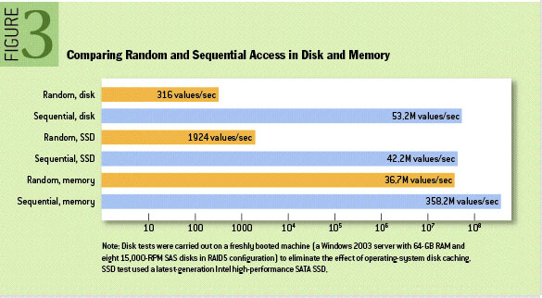
Disk Performance
http://queue.acm.org/detail.cfm?id=1563874

Slide 12
MQ Implantations
ZeroMQ: peer to peer, no broker; high throughout
ActiveMQ: both peer to peer & broker;
RabbitMQ: broker; Delivery Confirmation; Queue & Pub/Sub; DB Storage; Master/Slave
Kafka: Broker; High throughout; Consumer group; Persistence on Disk

Slide 13
References
消息队列实现精要 by 美团
Kafka design concerns
kafka documentation
Running Kafka At Scale
Reference Guide for Deploying and Configuring Apache Kafka
Kafka Ecosystem at LinkedIn
Kafka papers and presentations
Advanced Message Queue Protocol
AMQP architecture
RabbitMQ Internals
RocketMQ

Slide 14
Q&A

Slide 15
Indiction Training
Product / Develop / Operation
Software lifecycle
ITIL
Source Control
Evolution of A Website’s Architecture
AuAz & SSO
Cache
Message Queue
Storage
Database and SQL
NoSQL & New SQL
TOGAF & 4+1 Arch View
测试
发布
监控

